Slide 1
REARING ONE CLASS OF ANIMALS - CHICKEN
STEPS IN MAKING A DIORAMA

Slide 2
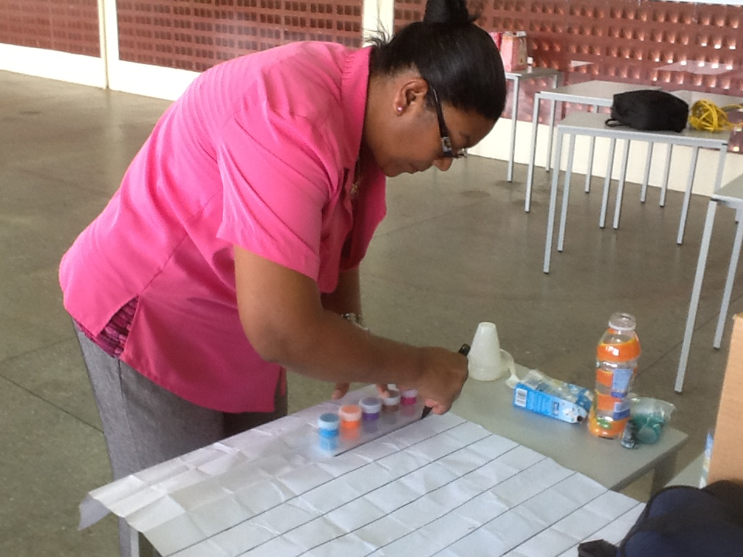
Make a background for your box.

Slide 3
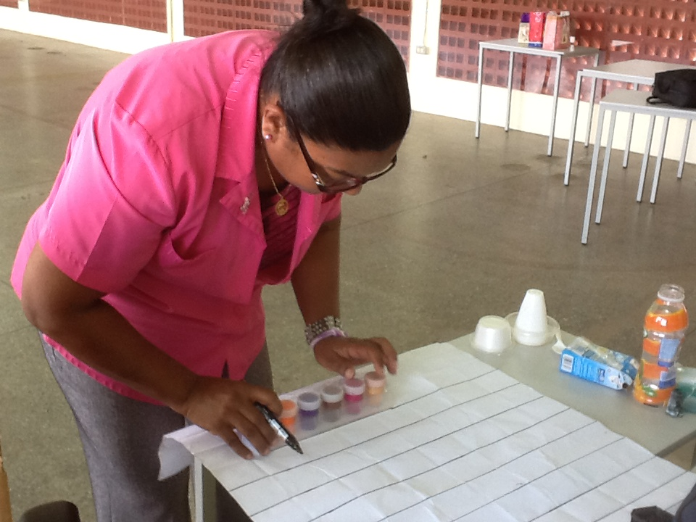
Here lines are being drawn to represent a cage.

Slide 4
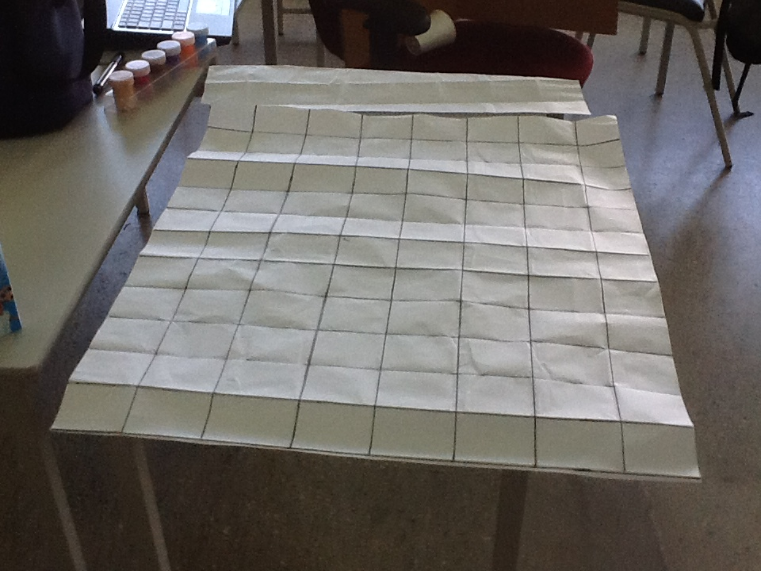
Here is the completed background of the cage.

Slide 5
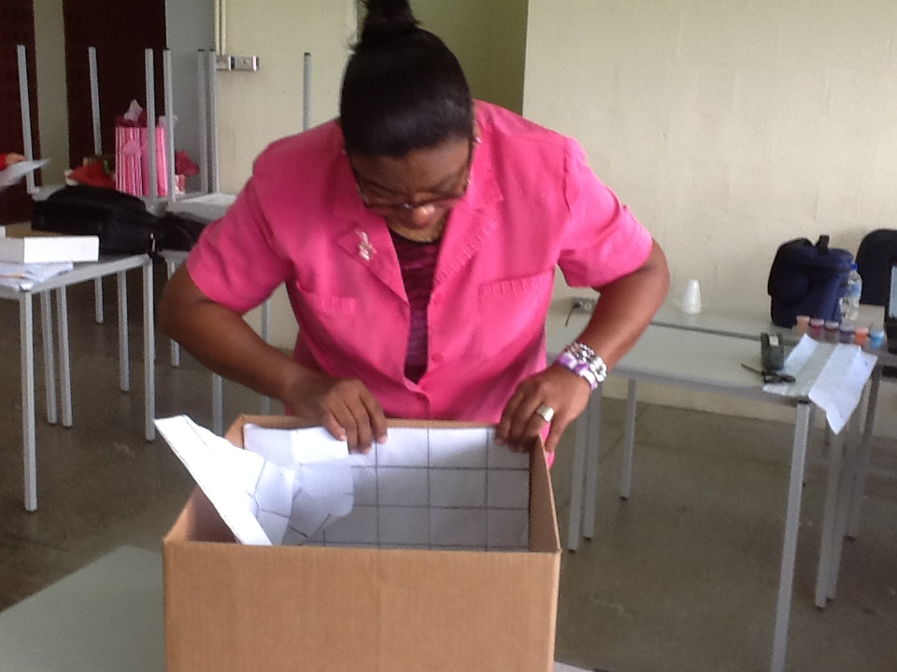
Line the box with the paper.

Slide 6
Line the bottom of the cage with litter.

Slide 7
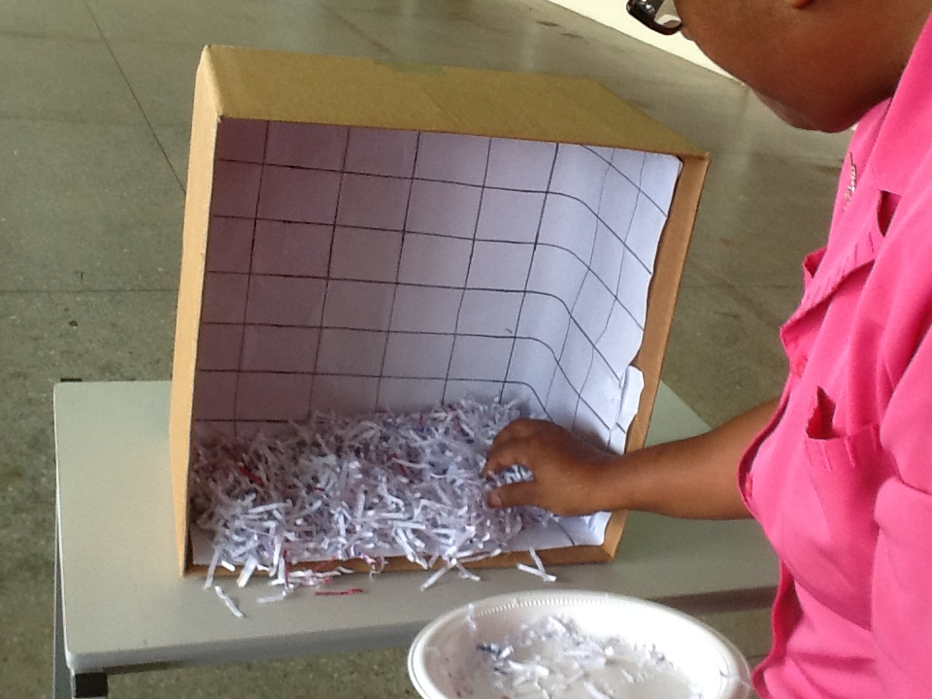
Ensure that the entire floor of the cage is covered with litter.

Slide 8
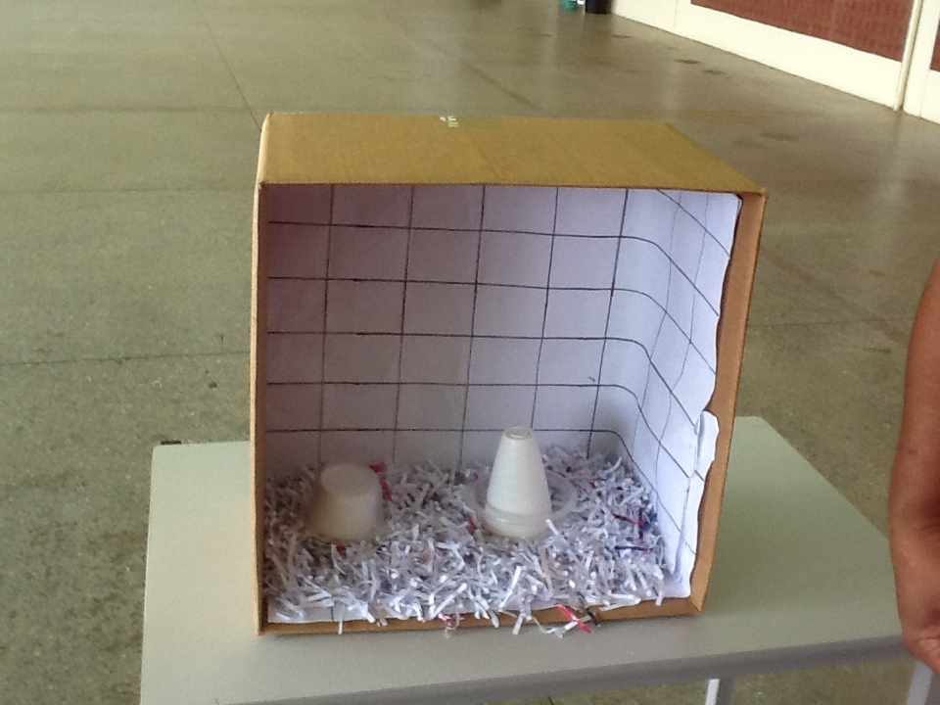
Put the automatic feeder and waterer in an appropriate place

Slide 9
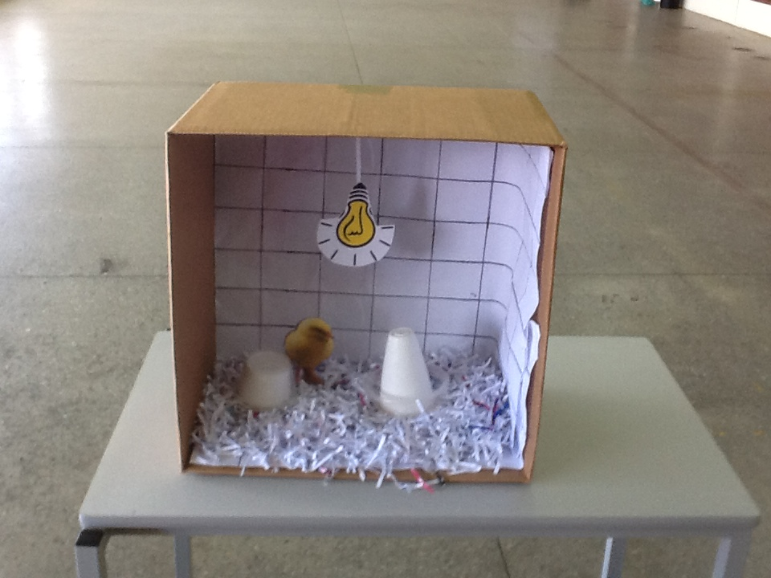
Place the lighting fixture at the top of the cage.
Add a cut out of a chick.

Slide 10
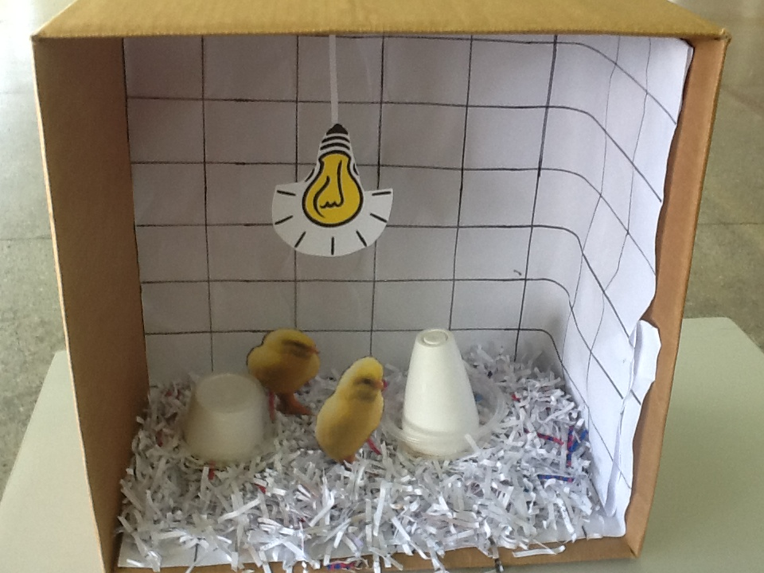
Add as many chicks as you wish.

Slide 11
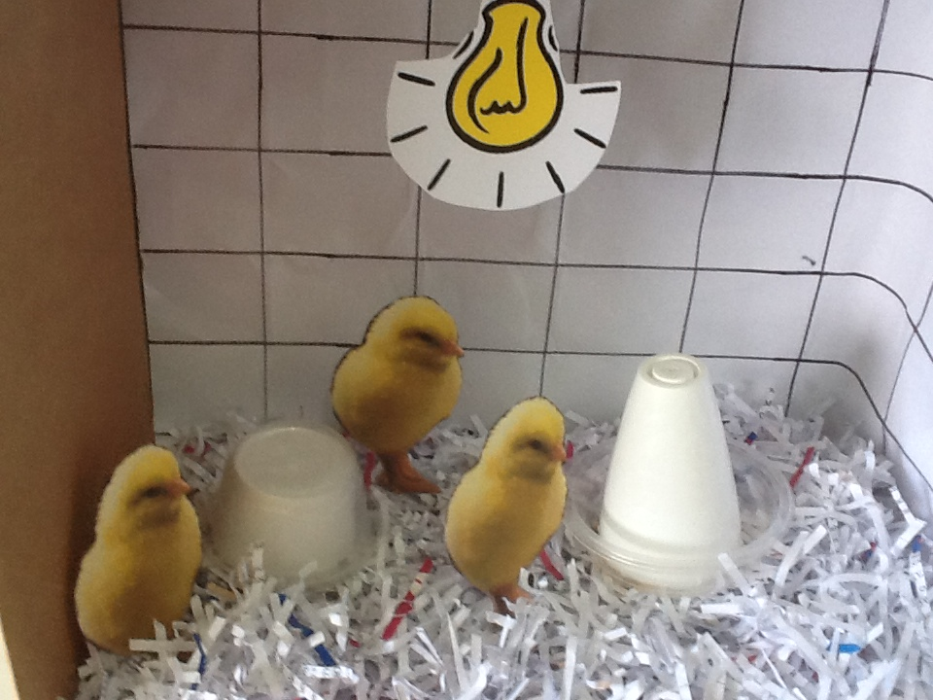
Look at those happy chicks!

